Slide 1



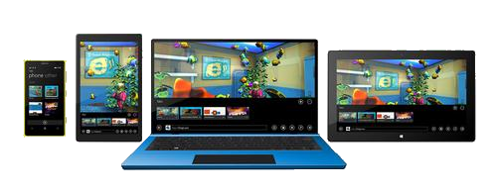
Universal Windows Platform Controls

Slide 2


Table of Contents
XAML Controls
Text controls
TextBlock and TextBox
RichEditBox
Buttons
Button and ToggleButton
CheckBox and RadioButton
List controls
ComboBox
ListView and GridView
Other controls
AppBar, ProgressBar and PopupMenu

Slide 3
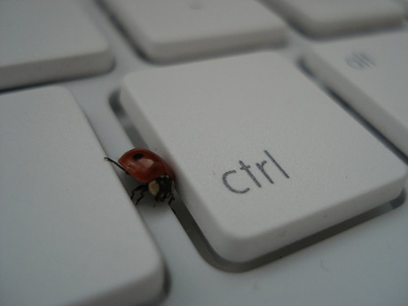
XAML Controls

Slide 4
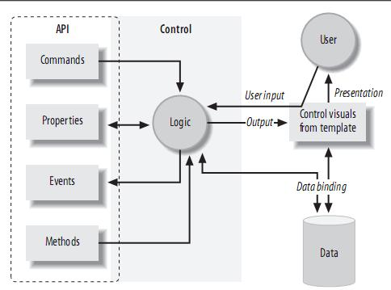
XAML Control
XAML Controls are typically not directly responsible for their own appearance
XAML Controls are all about behavior
They refer to templates to provide their visuals

Slide 5
XAML Controls (2)
Controls may use commands to represent supported operations
Controls offer properties to provide a means of modifying either behavior
Controls raise events when something important happens
UWP provides a range of built-in controls
Most of these correspond to standard Windows control types

Slide 6

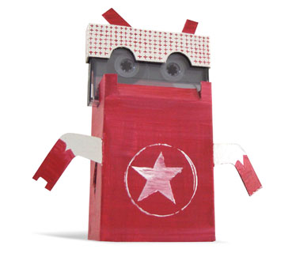
Text Controls

Slide 7

TextBlock
TextBlock a lightweight control for displaying small amounts of text
x:Name – Identifying name of the object
TextWrapping – How text should be wrapped
<TextBlock x:Name="TextBlock"
VerticalAlignment="Center"
HorizontalAlignment="Center"
FontSize="35"
FontWeight="Bold"
TextWrapping="Wrap"
Text="I am a TextBlock" />

Slide 8
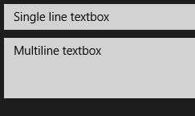
TextBox
TextBox a control that can be used to display single-format, multi-line text
By setting AcceptsReturn to true, it can edit multiple lines
ScrollViewer.VerticalScrollBarVisibility – attached property that gets/sets scrollbar visibility
PasswordBox
The users sees only the "*" symbol
<TextBox Margin="5" VerticalAlignment="Center"
Text="Single line textbox" />
<TextBox VerticalAlignment="Center" Margin="5"
Height="120" AcceptsReturn="True"
ScrollViewer.VerticalScrollBarVisibility="Visible"
Text="Multiline textbox" />

Slide 9
RichEditBox
RichEditBox supports all of the commands defined by the EditingCommands class
Recognize the RTF format
Paste formatted text from Internet Explorer and Word
Both TextBox and RichTextBox offer built-in spellchecking
IsSpellCheckEnabled property

Slide 10
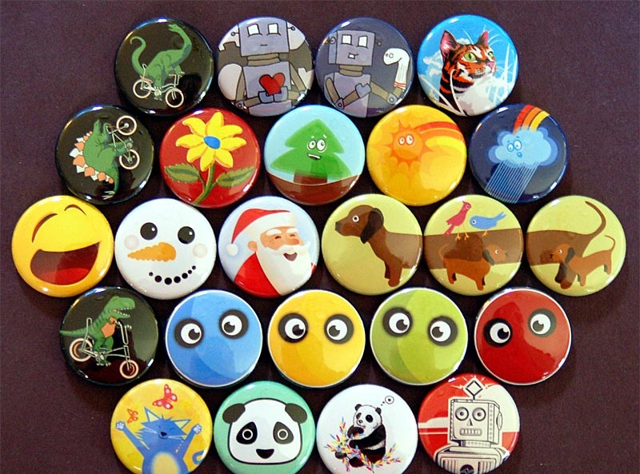
Buttons

Slide 11
Regular Button
UWP supports many types of buttons
Button – the regular button
Click event handler
Content property
Command property for command binding
<Button Content="Click me"
Click="OnButtonClick" />
<Button Content="Click me with command"
Command={Binding Click}" />

Slide 12
ToggleButton
Holds its state when it is clicked
IsChecked property
IsThreeState property
Determines whether the control supports two or three states
ToggleButton defines a separate event for each value of IsChecked
Checked for true
Unchecked for false
Indeterminate for null

Slide 13


CheckBox and RadioButton
They derive from ButtonBase indirectly via the ToggleButton class
IsChecked property, indicating whether the user has checked the button
CheckBox is nothing more than a ToggleButton with a different appearance
Radio buttons are normally used in groups in which only one button may be selected at a time

Slide 14
RadioButton - Example
Grouping radio buttons by name
<StackPanel>
<RadioButton GroupName="Fuel"
Margin="3">Petrol</RadioButton>
<RadioButton GroupName="Fuel"
Margin="3">Diesel</RadioButton>
<RadioButton GroupName="Induction"
Margin="3">Unforced</RadioButton>
<RadioButton GroupName="Induction"
Margin="3">Mechanical supercharger</RadioButton>
<RadioButton GroupName="Induction"
Margin="3">Turbocharger</RadioButton>
</StackPanel>

Slide 15
Other Buttons
HyperLinkButton
Navigates to a given URL through NavigateUri property
Click event handler
RepeatButton
Represents a control that raises its Click event repeatedly from the time it is pressed until it is released
<HyperlinkButton Content="Go to http://nikolay.it"
NavigateUri="http://nikolay.it"/>
<RepeatButton Width="100" DockPanel.Dock="Top"
Delay="500" Interval="100"
Click="Increase">Increase</RepeatButton>
void Increase(object sender, RoutedEventArgs e)
{
Int32 Num = Convert.ToInt32(valueText.Text);
valueText.Text = ((Num + 1).ToString());
}

Slide 16

List Controls

Slide 17

ComboBox
Enables users to select one item from a list
ComboBox defines two events
DropDownOpened
DropDownClosed
ComboBox can contain complex items

Slide 18
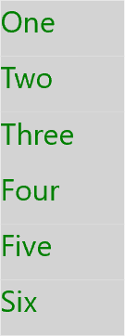
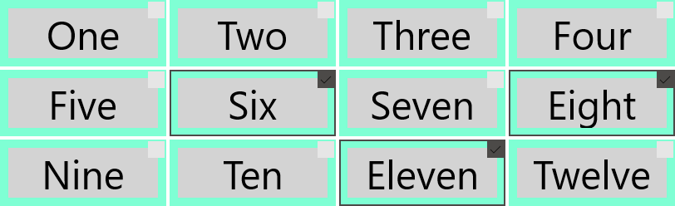
ListView and GridView
ListView - Displays a vertical list of data items
GridView - Displays a horizontal grid of data items
Both are ItemsControl, so they can contain a collection of items of any type
To populate:
Add items to the Items collection
Or set the ItemsSource property to a data source

Slide 19
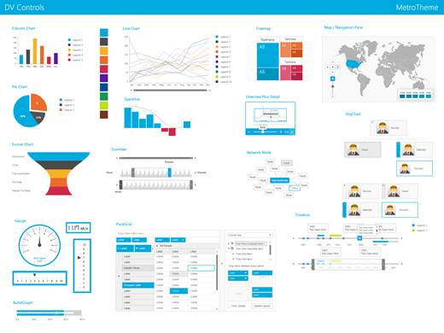
Other Controls

Slide 20
The AppBar
The AppBar is just a toolbar for displaying application specific commands
Like settings and shortcut commands
Can be either TopAppbar or BottomAppBar
<Page.BottomAppBar>
<AppBar>
<StackPanel Orientation="Horizontal">
<Button Name="AddButton" Content="Add" />
<Button Name="EditButton" Content="Edit" />
<Button Name="RemoveButton" Content="Remove" />
</StackPanel>
</AppBar>
</Page.BottomAppBar>

Slide 21


ProgressBar and ProgressRing
Progress bars are used to show the user that the applications is doing something
The application has not hanged
Two types of Progress bars
ProgressBar
ProgressRing
<ProgressBar IsIndeterminate="True" Width="100"/>
<ProgressRing IsActive="True"/>

Slide 22
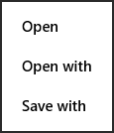
PopupMenu
PopupMenu is actually a context menu
It’s a simple container designed to hold Commands
Must be attached to a control using code behind
When a user right-taps on the control the context menu is displayed
PopupMenu popupMenu = new PopupMenu();
popupMenu.Commands.Add(new UICommand(…));
IUICommand chosenCommand = await popupMenu
.ShowForSelectionAsync(
GetElementRect((FrameworkElement)sender));

Slide 23
Universal Windows Platform Controls
http://academy.telerik.com

Slide 24
Exercises
Write a program that show the simple window with one TextBox. Add text to the TextBox. If you select some text in the TextBox – display the current selection information.
Write a program with a Button and a TextBlock. The TextBlock should show the number of clicks on the button.
Write a program that shows a ComboBox with various elements added to its Items. For example – add text, ellipse and picture.

